Slide 1


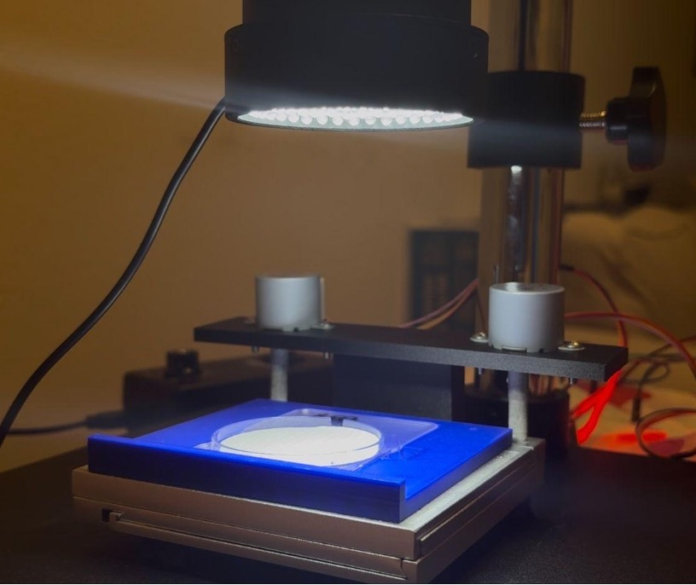
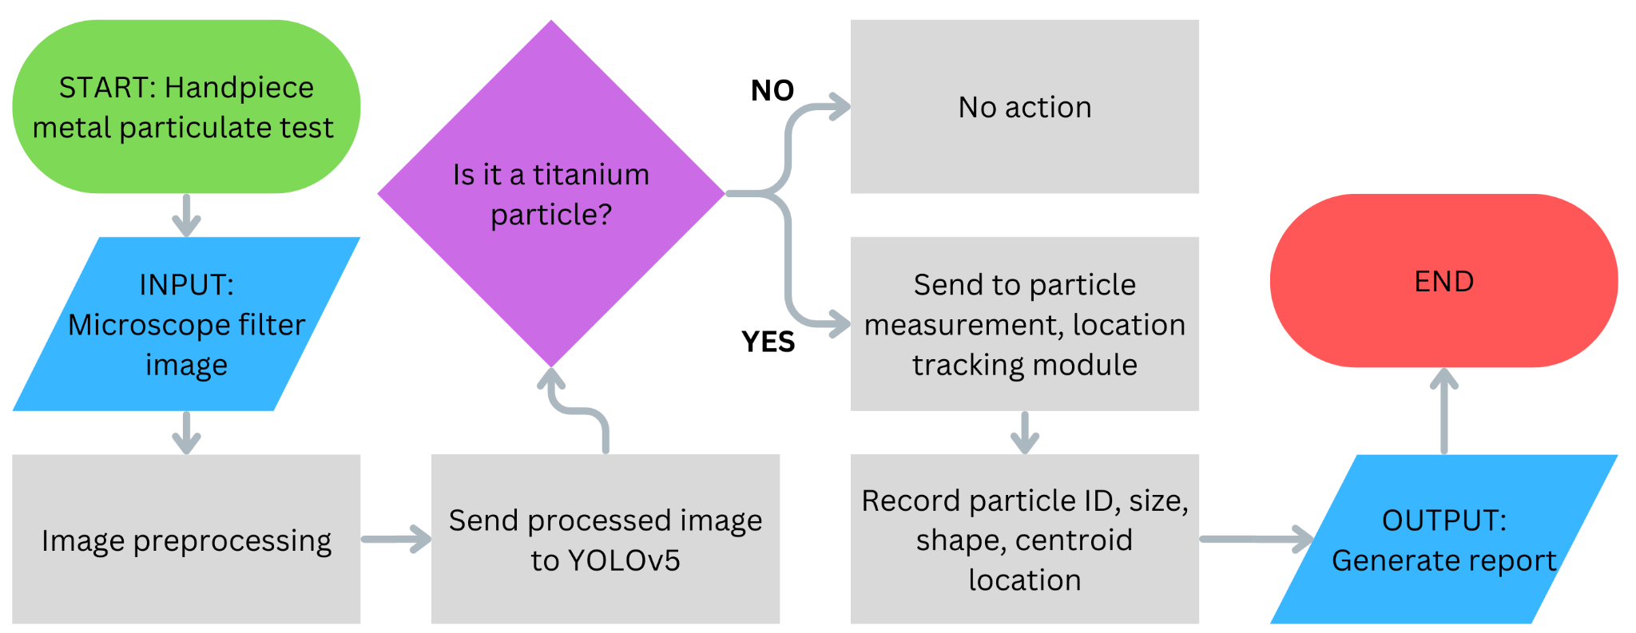
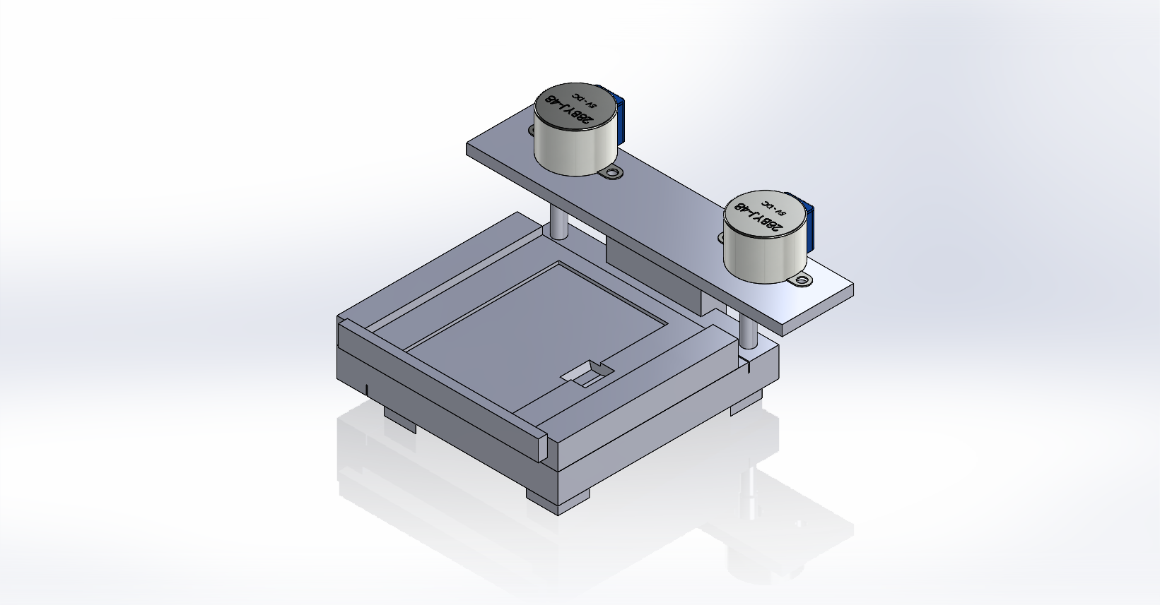
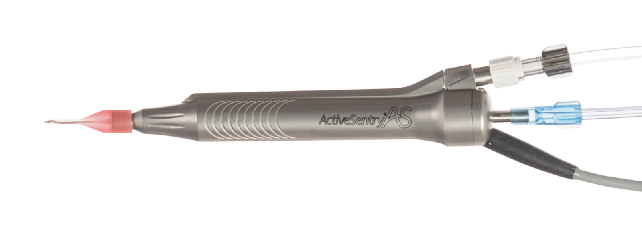
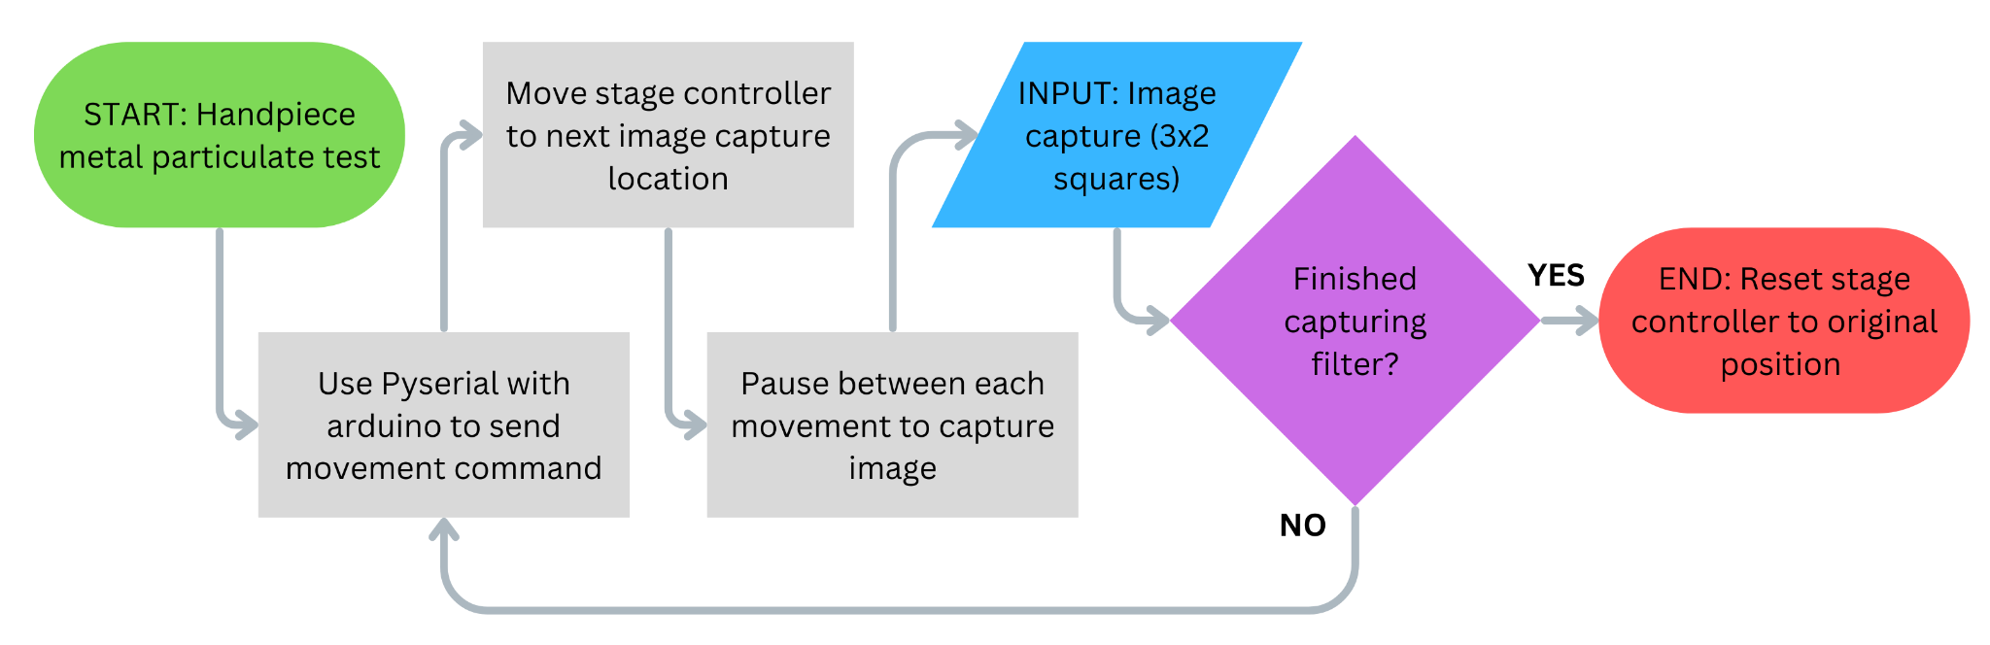
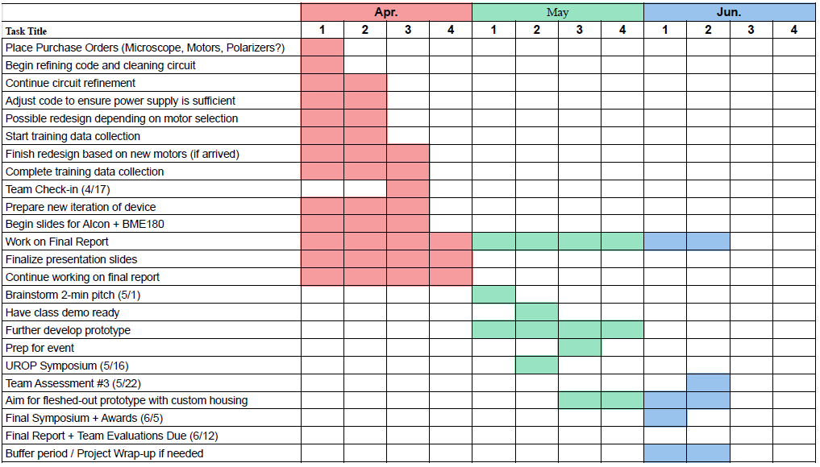
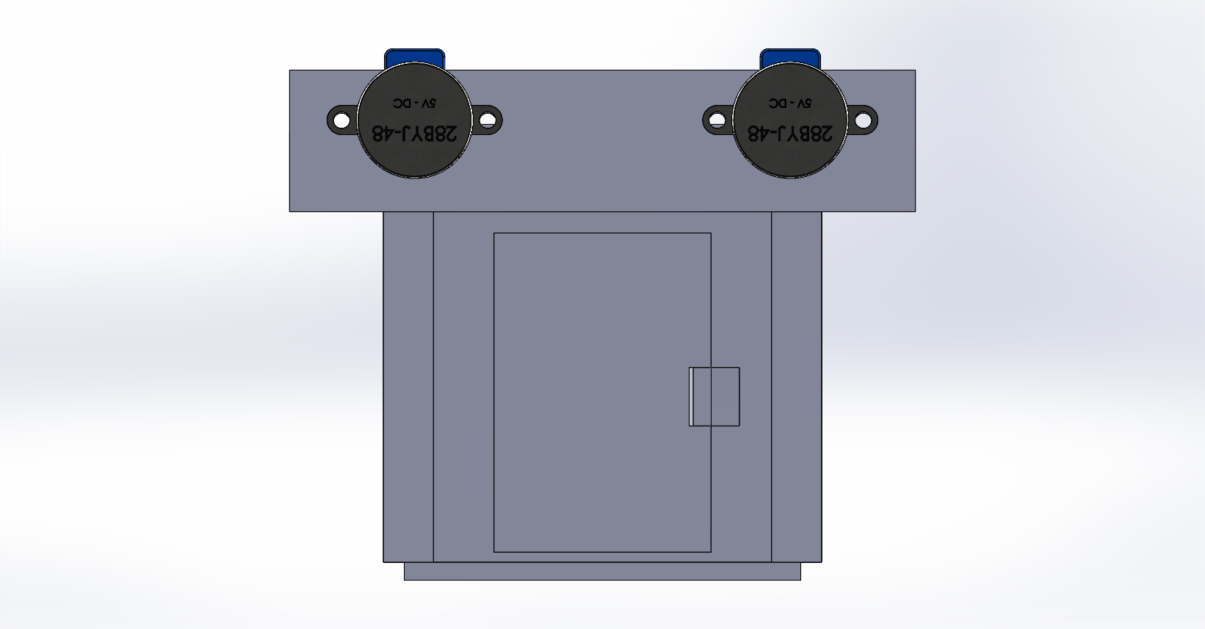
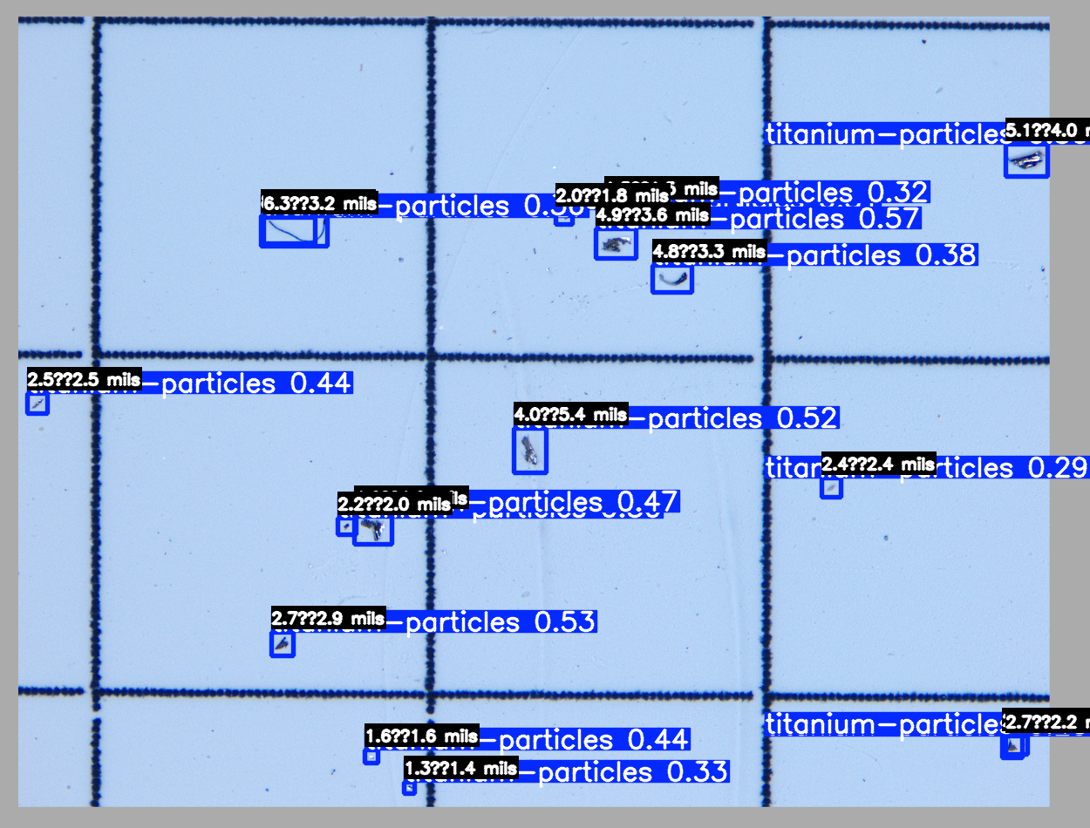
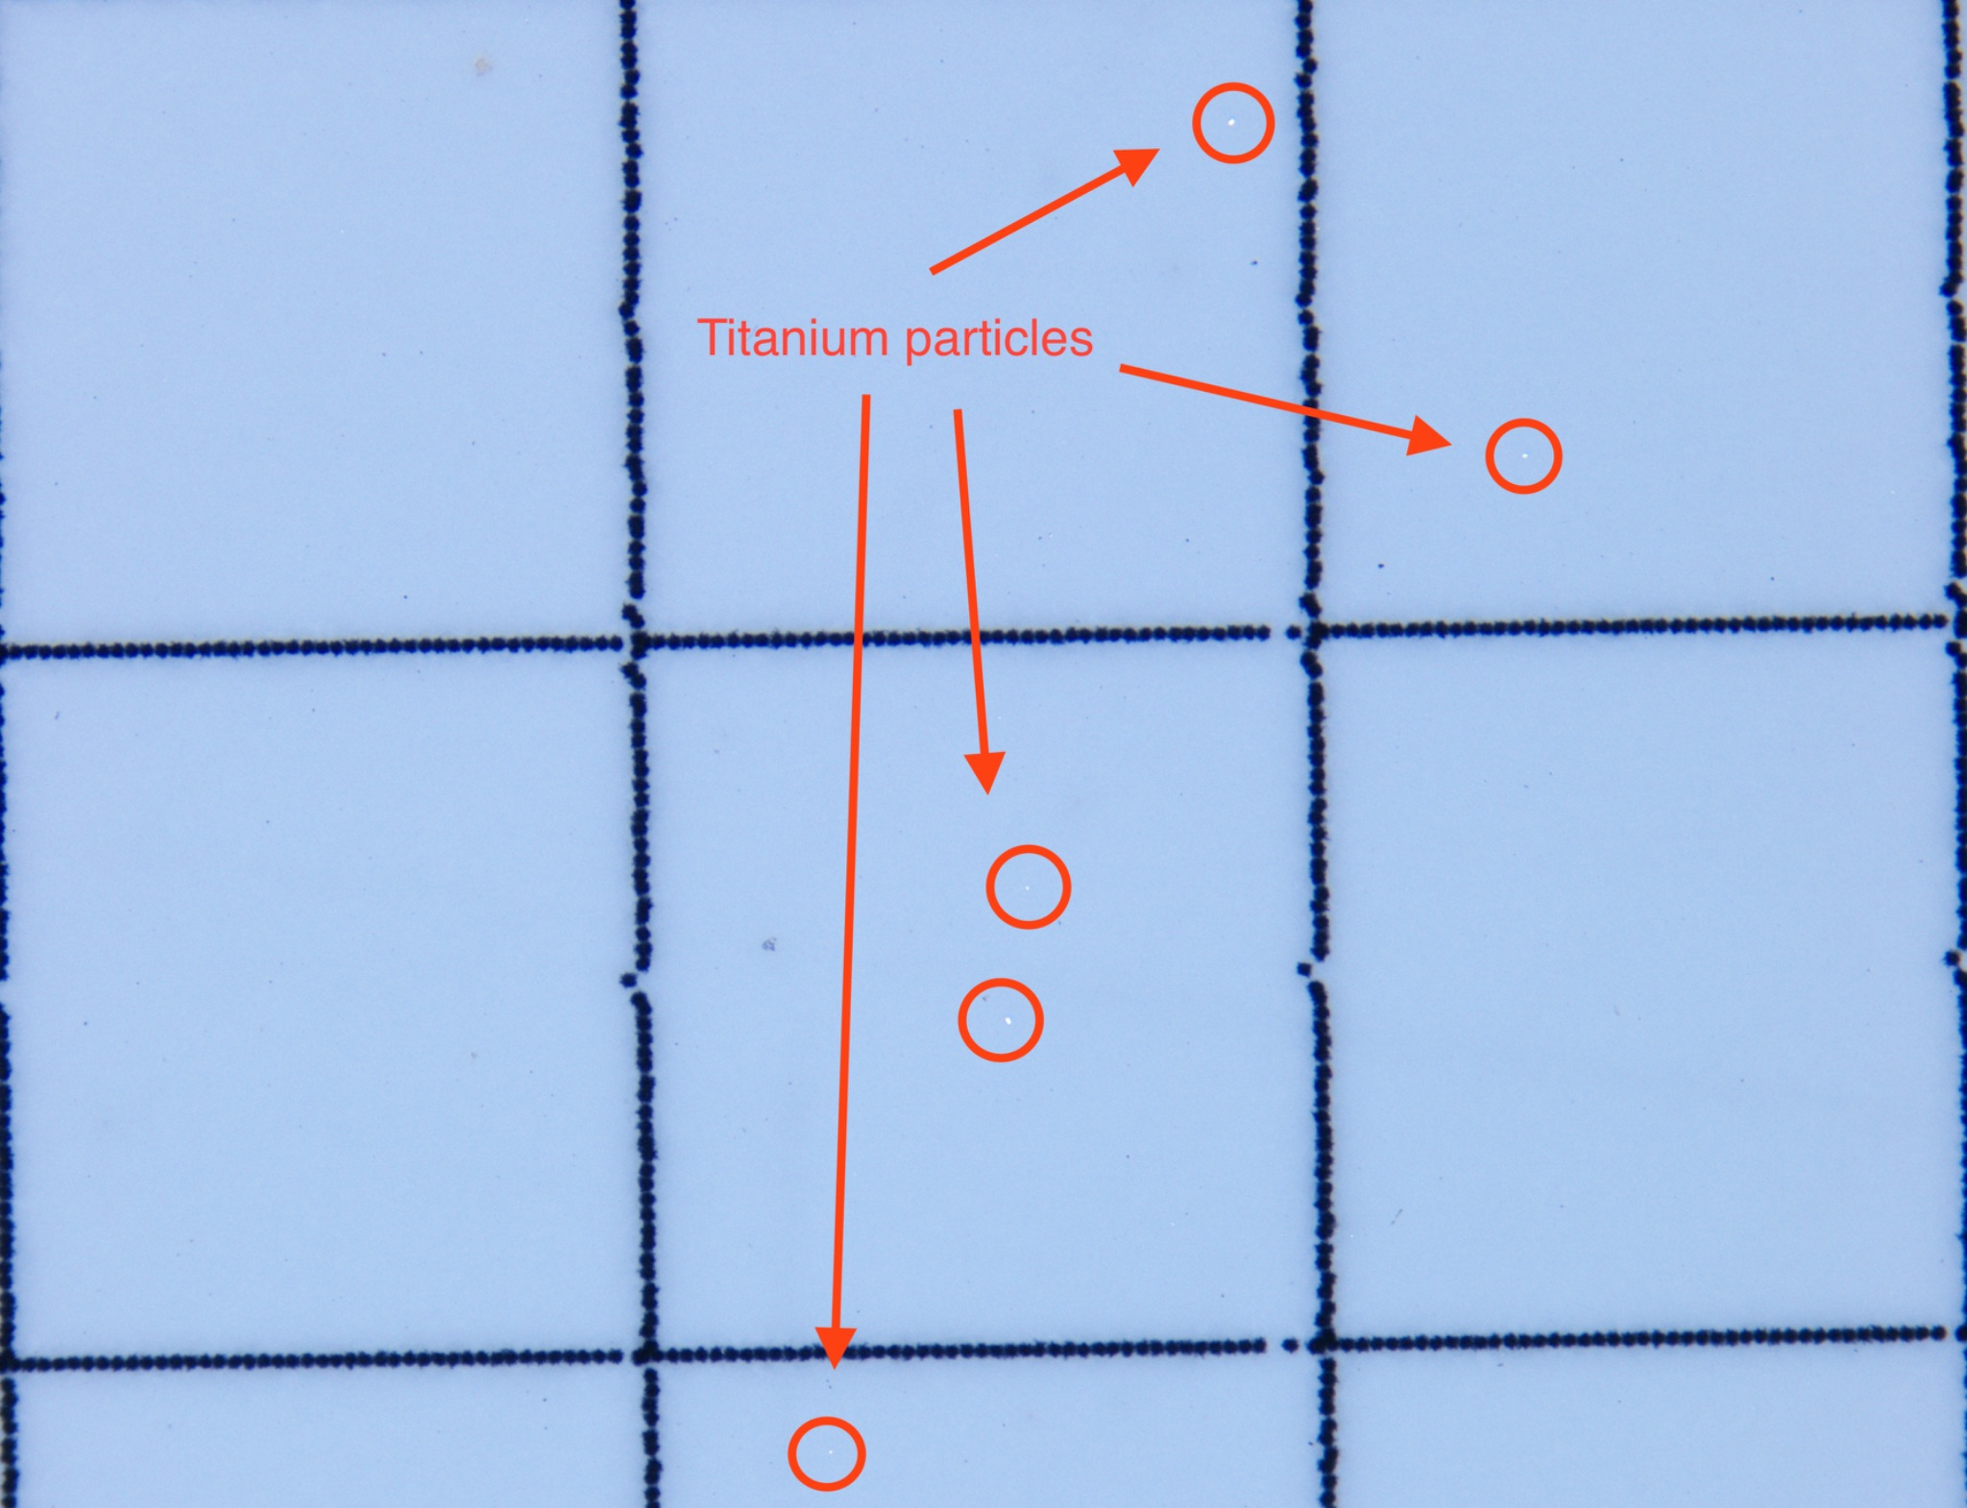
Automated Metal Particulate Counting
Team Members: Isaac Hoyt¹, Brian Ngo¹, Matthew Luong¹, Yolanda Gomez¹, Tandol Jerthsattayanukul¹, Landon Stein¹
Mentors: Camille Lo Porciuncula, Daj Rasberry, Tom Schacht, Diego Cueto, Christine King¹
¹Department of Biomedical Engineering, University of California, Irvine
BACKGROUND
PROJECT DESIGN
FAILURE MODES
The Active Sentry handpiece is a component of Alcon’s Centurion eye surgery system, and features a titanium housing. Titanium particles leftover from the machining process can irritate the eye’s tissues during a procedure, leading to damage or even retinal detachment [1]. Therefore, it is necessary to comply with standards such as USP 788 [2], which defines allowable particle limits, and ASTM F3127-22 [3], which validates cleaning processes used in medical device manufacturing.
Potential Failure Modes | Potential Failure Effects | Actions Recommended
Image analysis software incorrectly sizes particle | Generates inaccurate measurement, increases false positive tests | Perform quality assessment before each shift begins
Image analysis fails to identify particle | Generates inaccurate particle count, increases false positive tests | Perform quality assessment before each shift begins
Acquired image is too unfocused | Image will be harder to analyze leading to Failure Modes 1 and 2 | Routine check, clean station before morning shift begins
Stage controller does not move intended distance | Filter cannot be fully scanned | Calibration, follow the qualification test procedure
Figure 2: Completed Microscope Setup
Figure 4: Image Analysis Flow Chart
Table 3: Major Failure Modes and Mitigation
PROJECT TIMELINE
Figure 1: ACTIVE SENTRY Handpiece
After assembly, the handpieces undergo testing that concludes with a fluid flush of the device where the residual particles are captured by a membrane filter [4]. Currently, a technician manually inspects the filter with a microscope to count and measure the size of any titanium particles that they find.
To improve the efficiency and scalability of this quality control process, we aim to:
Develop a more efficient process for executing the metal particulate test on the Alcon’s manufacturing line.
Implement design changes and automated components to existing processes that comply with Alcon’s manufacturing standards.
Proposed Solution: A system that integrates an automatic stage controller with image analysis software powered by a convolutional neural network (CNN) to enhance the metal particulate test. The stage controller enables the microscope to capture images of the entire filter membrane, while the software processes these images to detect, measure, and track metal particles by analyzing metrics such as size and shape. The system will streamline the quality control process by generating a report with pass/fail assessments based on predefined quality standards.
Figure 5: Stage Controller Workflow
Criteria | Project Design | Validation
Stage Precision and Accuracy | Stepper Motor Control Through Python and Arduino. | Measurement of Displacement vs. Calculated Displacement.
Automation & Integration Capability | Development of Python-Based System for Complete Automation. | Seamless Transitions Between Steps Within Code.
Particle Detection & Measurement | Capture Discrete Images of Filter. YOLO AI for Detection and Quantification. | Images are Clear and Saved Correctly. YOLO AI Compared Against Technician Measurements.
Data Accessibility | Simple GUI for Easy Starting, Monitoring, and Reviewing. Simple File Storage Structure. | Intuitive Navigability, Verification that All Processed Data is Easily Accessible.
Figure 3: Assembly of Stage Controller
CONTACT INFO
Rails (A), stage top (B), stepper motor holders (C), knobs (D).
A. The railing facilitates removal of the stage top, ensuring easy maintenance.
B. The stage top securely holds the filter membrane and its casing while incorporating a slot for quick removal.
C. Stepper motor holders pass through the knob and fixate motors position.
D. Knobs connect the motors to the microscope stage, enabling controlled gear movement.
Isaac Hoyt: hoyti@uci.edu
Yolanda Gomez: yagomez1@uci.edu
Matthew Luong: luongmt2@uci.edu
Tandol Jerthsattayanukul: tjerthsa@uci.edu
Landon Stein: lnstein@uci.edu
Brian Ngo: bpngo2@uci.edu
Table 1: Design and Validation Criteria
Customer Requirement | Acceptance Criteria | Test
Automation Capability | Yes/No | Functional Test
Speed of Operation | <20-30 minutes per quantity 10 work order | Time comparison
Accuracy | Matches technician accuracy | Functional Test
Cost-Effectiveness | Equivalent to or cheaper than current process | Functional Test
REFERENCES
Table 1: Design Criteria and Validation Plan
The table outlines our project’s key criteria, detailing the planned implementation of hardware and software components alongside their validation methods to ensure practical functionality. The particle detection and measurement system must accurately identify and size metal particles, classifying them based on a predefined threshold. To ensure reliability, the system’s results will be compared against a technician’s assessments. These criteria will enable a streamlined execution of the process, reducing overall time and improving consistency in particulate counting.
[1] A. P. Brezin, “Surgical Performance of CENTURION Vision System with Active Sentry,” Cataract & Refractive Surgery Today. https://crstoday.com/articles/surgical-performance-of-centurion-vision-system-with-active-sentry/surgical-performance-of-centurion-vision-system-with-active-sentry.
[2] Standard Guide for Validating Cleaning Processes Used During the Manufacture of Medical Devices. West Conshohocken, PA: ASTM International, 2022.
[3] United States Pharmacopeia , “<788> Particulate Matter in Injections,” Jun. 29, 2012.
[4] “Alcon Centurion® Vision System | Alcon Professional,” MyAlcon. https://www.myalcon.com/professional/cataract-surgery/surgical-equipment/centurion/
Table 2: Testing Requirement Criteria
Figure 6: Image of Filter Containing Metal Particulate

